Slide 1
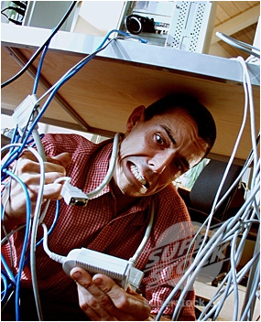

Sustainable software development
From a hacker...
… to a craftsman!

Slide 2
Sustainable software development
Workshop with Mikael Kalms, Technical Director at DICE
We're going to talk tools, mindset and tactics.
You are going to criticize my code.
I am going to criticize yours. (Any volunteers?)

